Slide 1
BEST practices: Security Controls in Shared Source Code Repositories
Alexis Yang | CSD 380 Module 11 | 21 July 2024

Slide 2
Agenda
Introduction
Access Controls
Authentication and Authorization
Code Review and Approval Workflows
Secure Coding Practices
Encryption
Monitoring and Auditing
Incident Response
Conclusion

Slide 3
Introduction
Shared source code repositories are critical for collaborative development but pose significant security risks if not properly secured.
Unauthorized access, malicious code injections, and data breaches can compromise the integrity of the software and expose sensitive information.

Slide 4
Access Controls
Least Privilege Principle:
Users should only have the minimum level of access necessary to perform their job functions.
Regular Reviews:
Periodically audit and update user permissions to ensure they remain appropriate.
Role-Based Access Control (RBAC):
Assign roles with specific permissions to users to limit access based on their role within the project.
Tools with Built-in Mechanisms:
GitHub
GitLab
BitBucket

Slide 5
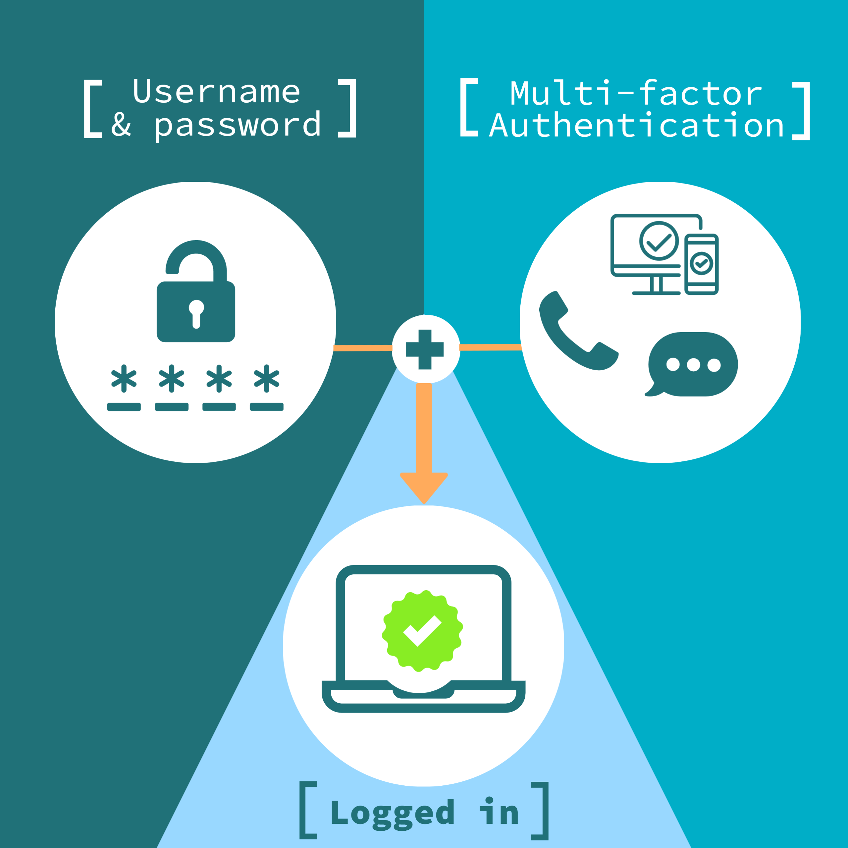
Authentication and Authorization
Best Practices:
Enforce multi-factor authentication (MFA).
Integrate Single Sign-On (SSO) solutions.
Utilize OAuth for secure authorization.
Source:
Schneider, J. (2022). Securing code repositories: Best practices for authentication. Journal of Cybersecurity, 15(3), 45-58.

Slide 6
Code Review and Approval Workflows
Require code reviews for all changes.
Ensure that all changes are reviewed by one or more team members to catch potential issues early.
Implement branch protection rules.
Restrict direct commits to critical branches (e.g., main/master) and require pull requests.
Use automated testing and continuous integration (CI) pipelines.
Verifies code changes before merging.
Walker, L. (2021). Effective code review strategies. Software Engineering Journal, 10(4), 112-126.

Slide 7

Secure Coding Practices
Secure Coding Standards:
Follow guidelines such as those provided by OWASP to avoid common vulnerabilities.
Training:
Regularly educate developers on secure coding practices and emerging threats.
Analysis Tools:
Utilize static analysis tools to check code for vulnerabilities and dynamic analysis tools to test running applications.
OWASP. (2023). Secure coding practices. Retrieved from https://owasp.org/www-project-secure-coding-practices/.

Slide 8
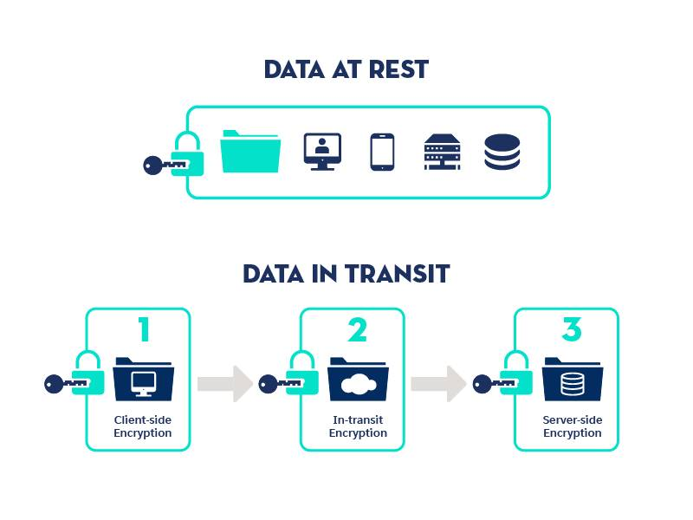
Encryption
Encrypt Data at Rest:
Protect stored data using encryption to prevent unauthorized access in case of a breach.
Encrypt Data in Transit:
Use protocols like TLS/SSL to secure data transmitted between users and the repository.
National Institute of Standards and Technology (NIST). (2022). Encryption and key management. NIST Special Publication 800-57.

Slide 9
Monitoring and Auditing
Activity Logs:
Maintain detailed logs of all repository activities to detect and investigate suspicious actions.
Regular Audits:
Conduct regular security audits to identify and address potential vulnerabilities.
Smith, A. (2023). The role of auditing in secure software development. Cyber Defense Review, 18(2), 72-88.

Slide 10
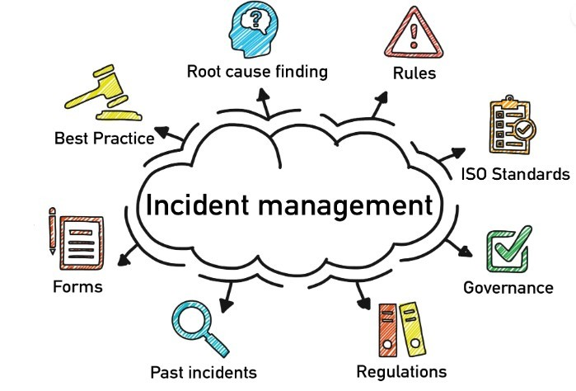
Incident Response
Response Plan:
Develop and maintain an incident response plan tailored to handle security breaches in the repository.
Rapid Identification:
Quickly identify and assess the scope of the incident.
Mitigation and Recovery:
Implement measures to contain and mitigate the breach and restore normal operations.
Johnson, M. (2022). Incident response for software repositories. Information Security Journal, 30(4), 210-225.

Slide 11
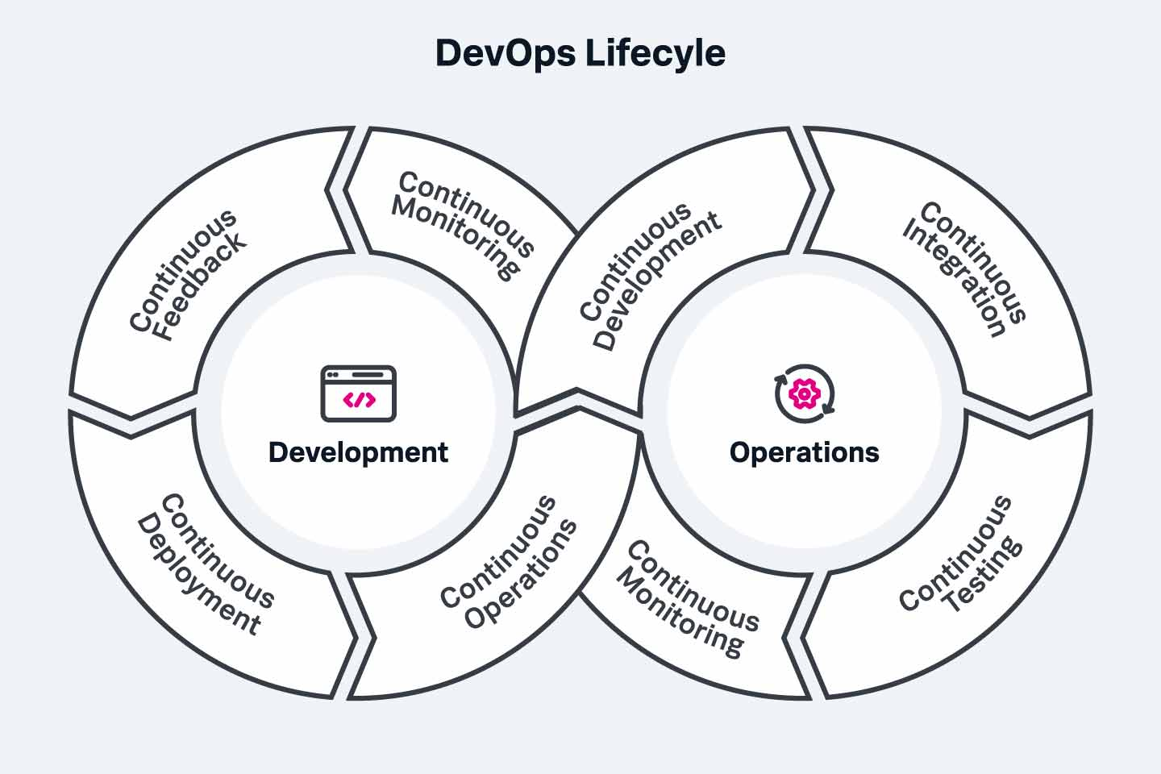
Conclusion
Securing shared source code repositories is critical for maintaining software integrity and protecting sensitive information.
Future Considerations:
Stay updated with emerging threats and continuously improve security measures.

